Slide 1
An outlier is a data point that significantly differs from other observations in a dataset. Outliers stand out as unusual values because they fall far outside the general distribution pattern. They can be unusually high or low values compared to the rest of the data.
Outliers can result from:
Natural variability: Some observations may genuinely differ greatly from others.
Measurement error: Errors in data collection, entry, or recording.
Sampling issues: Certain conditions in sampling that might lead to extreme values
Outliers can influence statistical analyses, such as the mean and standard deviation, and may need to be handled carefully to ensure accurate data analysis.

Slide 2
Anomalies
Definition: Anomalies are unusual data points that are suspected to be incorrect, malicious, or represent rare, exceptional events.
Cause: Anomalies are often caused by issues like fraud, network intrusions, or system failures.
Example: In network traffic, a sudden spike in data transfer that doesn’t match the usual pattern could be an anomaly indicating potential security issues.
Interpretation: Anomalies are seen as potential indicators of something notable or abnormal, often warranting further investigation.
Detection: Detected using specialized anomaly detection techniques (e.g., machine learning algorithms, time-series analysis, clustering).

Slide 3
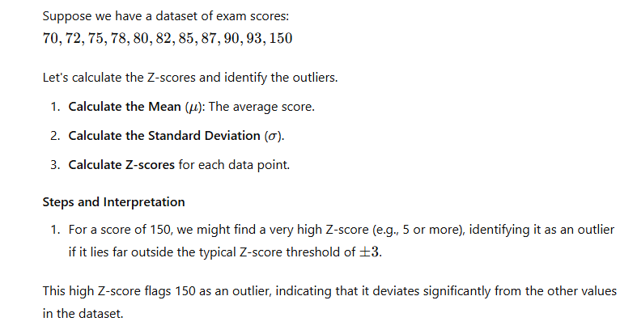

Slide 4
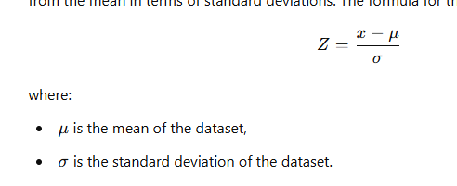
Interpret the Z-score to Identify Outliers
Typically:
Z-scores between -3 and +3 are considered within the normal range.
Z-scores beyond ±3 (often beyond ±2 in some contexts) indicate potential outliers.
Data points with a Z-score less than -3 or greater than +3 are often flagged as outliers. Adjust the threshold based on your specific dataset and tolerance for outliers.

Slide 5
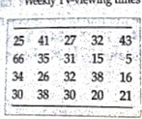


Slide 6


obtain the quartiles.
b. determine the interquartile range. c.
find the five-number summary.
Plot each potentialoutlierwithanasterisk

Slide 7



Slide 8



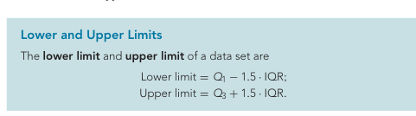

Slide 9
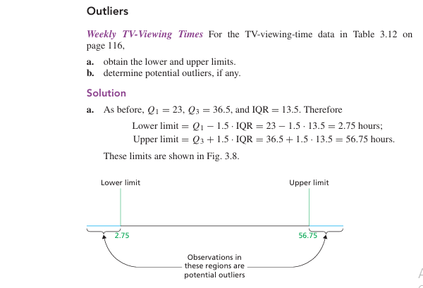

Slide 10
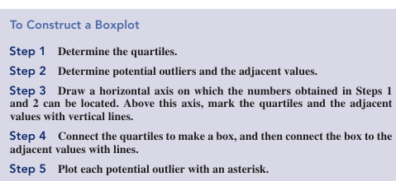

Slide 11
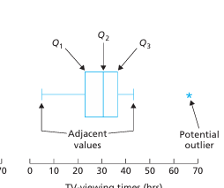

Slide 12
